Slide 1
Dimensionality Reduction
Trainer : Arun Ravi

Slide 2


Slide 3


Slide 4
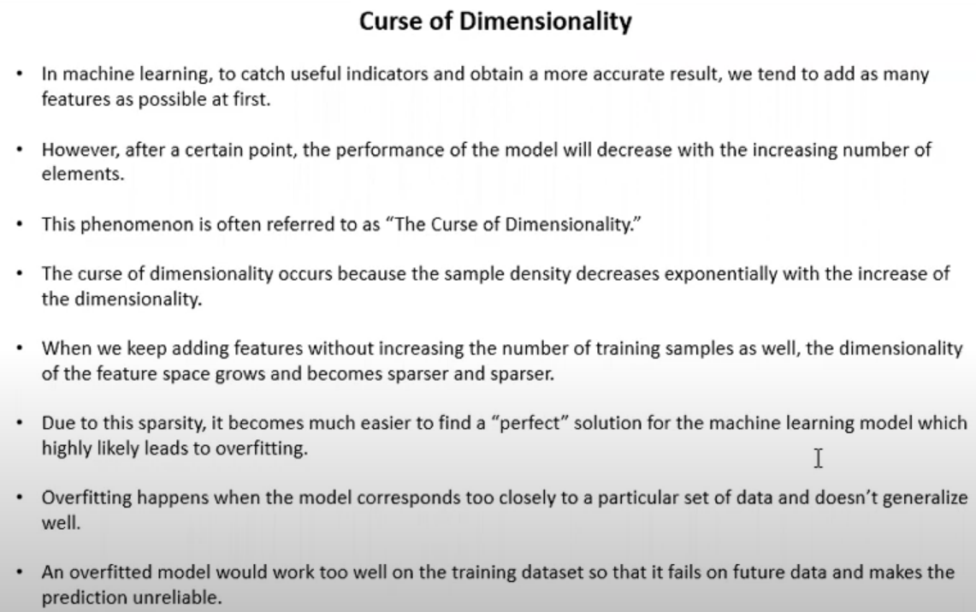

Slide 5
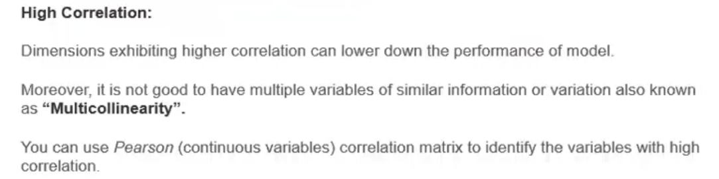

Slide 6

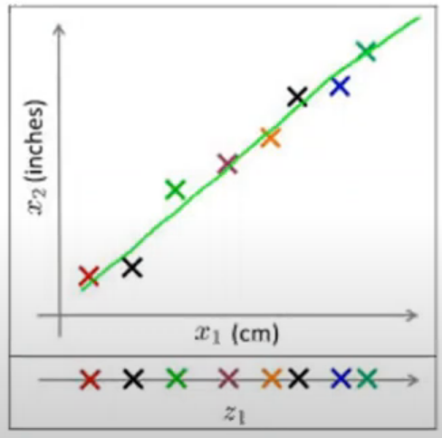


Slide 7
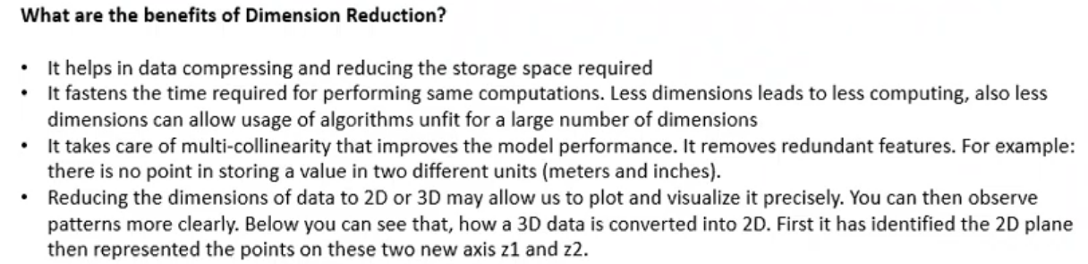
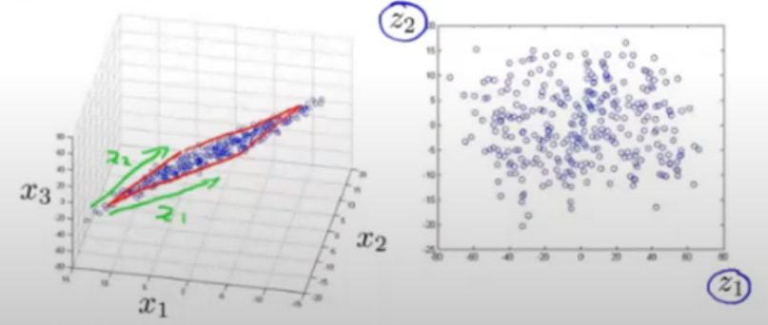

Slide 8
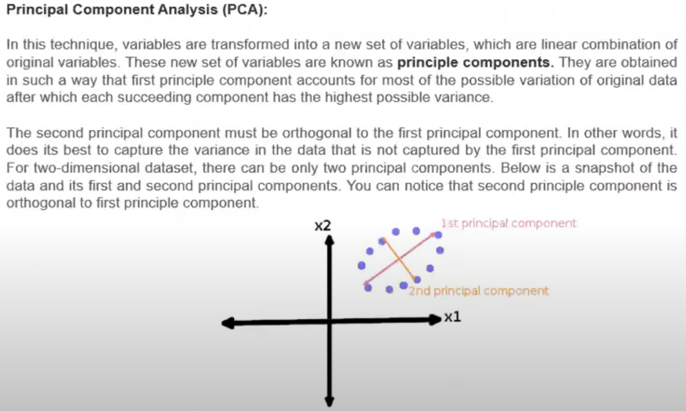

Slide 9


Slide 10


Slide 11
Mathematical Approach to PCA
What is PCA?
The main guiding principle for Principal Component Analysis is FEATURE EXTRACTION i.e. “Features of a data set should be less as well as the similarity between each other is very less.” In PCA, a new set of features are extracted from the original features which are quite dissimilar in nature. So, an n-dimensional feature space gets transformed into an m-dimensional feature space., where the dimensions are orthogonal to each other.

Slide 12

Concept of Orthogonality:
In order to understand this topic, we have to go to the vector space concept in linear algebra). Vector Space is a set of vectors. They can be represented as a linear combination of the smaller set of vectors called BASIS VECTORS. So any vector ‘v’ in a vector space can be represented as:
where a represent ‘n’ scalars and u represents the basis vectors. Basis vectors are orthogonal to each other. Orthogonality of vectors can be thought of an extension of the vectors being perpendicular in a 2-D vector space. So our feature vector (data-set) can be transformed into a set of principal components (just like the basis vectors)

Slide 13
Objectives of PCA :
1. The new features are distinct i.e. the covariance between the new features (in case of PCA, they are the principal components) is 0.
2. The principal components are generated in order of the variability in the data that it captures. Hence, the first principal component should capture the maximum variability, the second one should capture the next highest variability etc.
3. The sum of the variance of the new features / the principal components should be equal to the sum of the variance of the original features.

Slide 14
Working of PCA :
PCA works on a process called Eigenvalue Decomposition of a covariance matrix of a data set. The steps are as follows:
1. First, calculate the covariance matrix of a data set.
2. Then, calculate the eigenvectors of the covariance matrix.
3. The eigenvector having the highest eigenvalue represents the direction in which there is the highest variance. So, this will help in identifying the first principal component.
4. The eigenvector having the next highest eigenvalue represents the direction in which data has the highest remaining variance and also orthogonal to the first direction. So, this helps in identifying the second principal component.
5. Like this, identify the top ‘k’ eigenvectors having top ‘k’ eigenvalues to get the ‘k’ principal components.

Slide 15
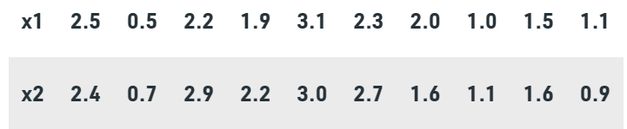
Numerical for PCA :
Consider the following dataset
Step 1: Standardize the Dataset
Mean for x1 = 1.81 = x1mean
Mean for x2 = 1.91 = x2mean
We will change the dataset.
X1
0.69 | -1.31 | 0.39 | 0.09 | 1.29 | 0.49 | 0.19 | -0.81 | -0.31 | -0.71
0.49 | -1.21 | 0.99 | 0.29 | 1.09 | 0.79 | -0.31 | -0.80 | -0.31 | -1.01
X2

Slide 16




Step 2: Find the Eigenvalues and eigenvectors
Correlation Matrix (c)
where, X is the Dataset Matrix (In this numerical, it is a 10 X 2 matrix)
X^T is the transpose of the X (In this numerical, it is a 2 X 10 matrix) and N is the number of elements = 10
So,
So, in order to calculate the Correlation Matrix, we have to do the multiplication of the Dataset Matrix with its transpose
Using the equation,
where λ is the eigenvalue and I is the Identity Matrix

Slide 17


Solving equation (i)
Taking the determinant of the left side, we get
We get two values for λ, that are (λ1) = 1.28403 and (λ2) = 0.0490834.
Now we have to find the eigenvectors for the eigenvalues λ1 and λ2

Slide 18
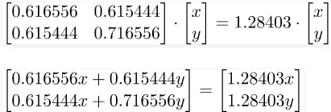

To find the eigenvectors from the eigenvalues, we will use the following approach:
First, we will find the eigenvectors for the eigen value 1.28403 by using the equation
Solving the matrices, we get
0.616556x + 0.615444y = 1.28403x
x = 0.922049y
(x and y belongs to the matrix X) so if we put y = 1, x comes out to be 0.922049. So now the updated X matrix will look like:

Slide 19
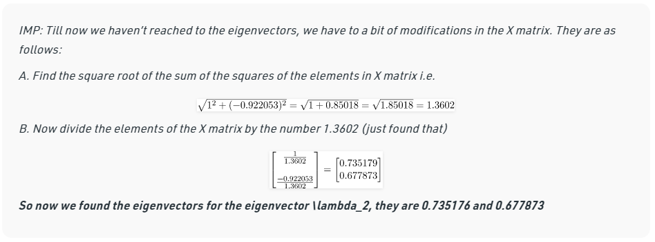
Sum of eigenvalues λ1 and λ2 = 1.28403 + 0.0490834 = 1.33 = Total Variance Majority of variance comes from λ1

Slide 20
Step 3: Arrange Eigenvalues
The eigenvector with the highest eigenvalue is the Principal Component of the dataset. So in this case, eigenvectors of λ1 are the principal components.
Basically in order to complete the numerical we have to only solve till this step, but if we have to prove why we have chosen that particular eigenvector we have to follow the steps from 4 to 6

Slide 21

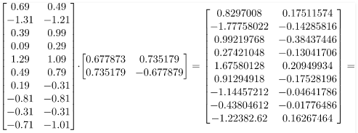
Step 4: Form Feature Vector
This is the FEATURE VECTOR for Numerical
Where first column are the eigenvectors of λ1 & second column are the eigenvectors of λ2
Step 5: Transform Original Dataset
Use the equation Z = X V
Z

Slide 22
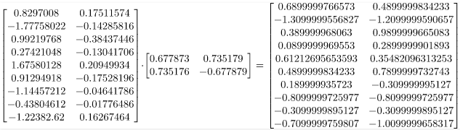
Step 6: Reconstructing Data
Use the equation X = Z* (V^T)
(V^T) is Transpose of V,
X = Row Zero Mean Data

Slide 23
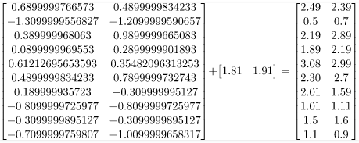
Row Original DataSet = Row Zero Mean Data + Original Mean
So for the eigenvectors of first eigenvalue, data can be reconstructed similar to the original dataset. Thus we can say that the Principal Component of the dataset is λ1 is 1.28403 followed by λ2 that is 0.0490834

Slide 24
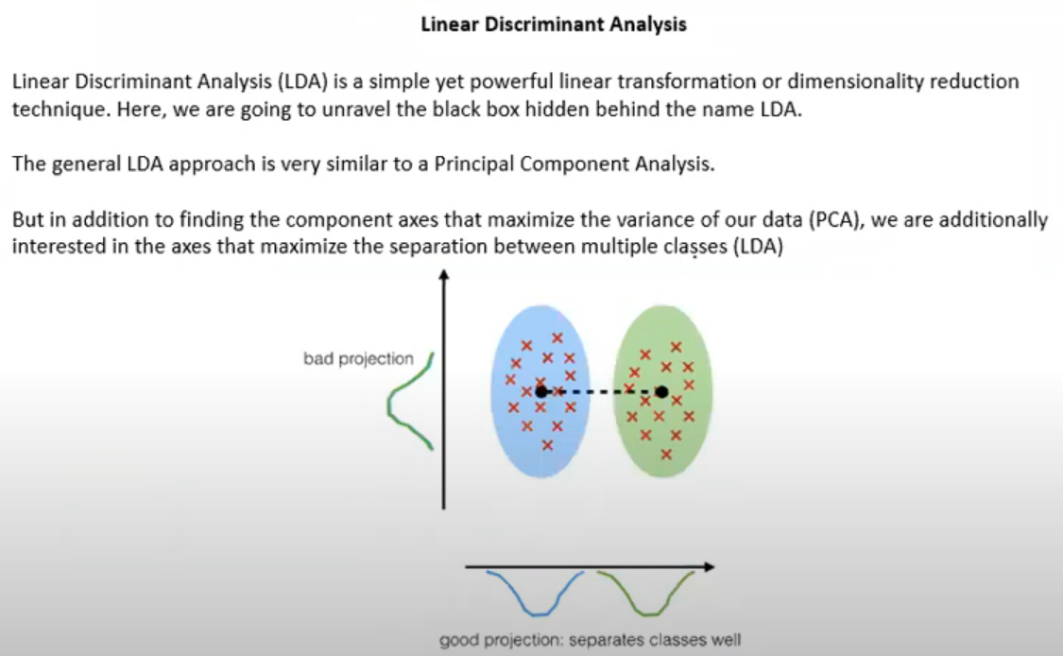

Slide 25
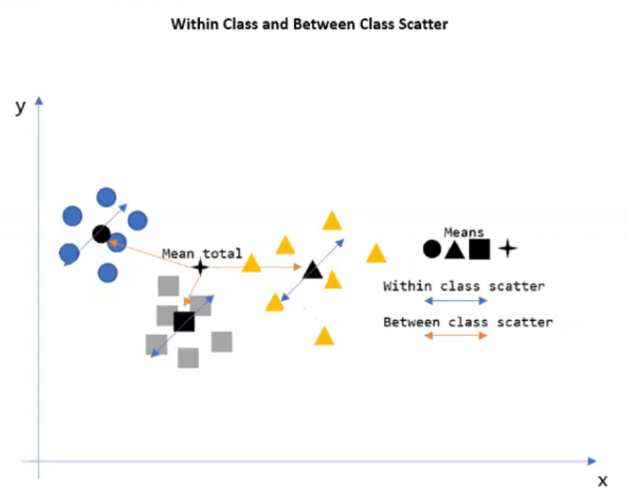

Slide 26
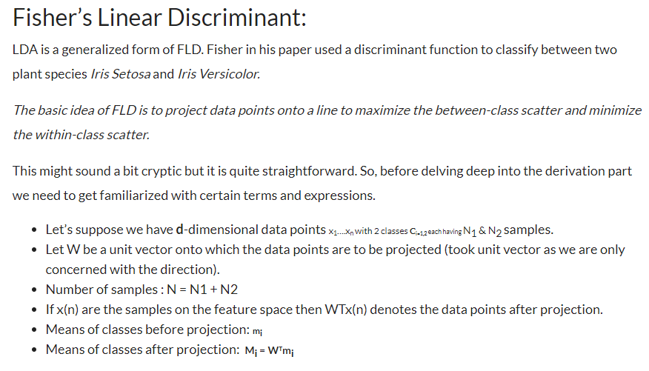
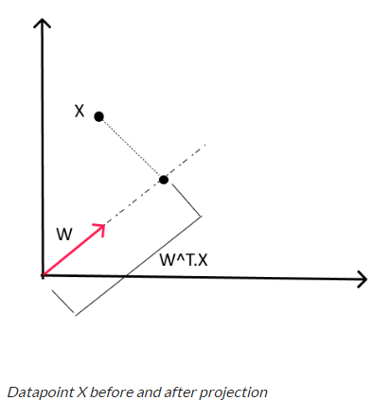

Slide 27
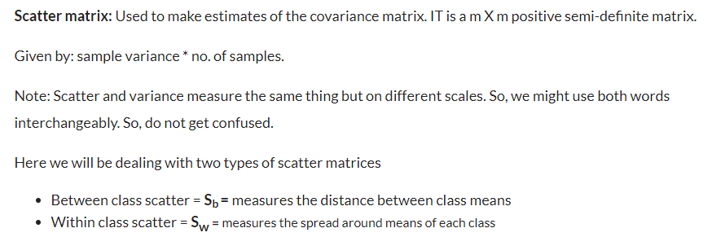
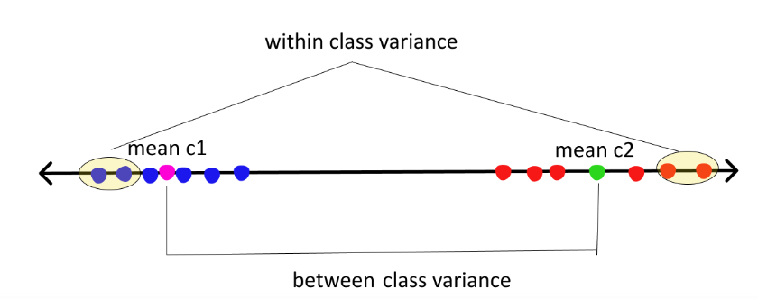

Slide 28

The numerator here is between class scatter while the denominator is within-class scatter. So to maximize the function we need to maximize the numerator and minimize the denominator, simple math. To maximize the above function we need to first express the above equation in terms of W.

Slide 29
References
Books :
Applied Business Statistics - Ken Black
Naked Statistics: Stripping the Dread from the Data - Charles Wheelan
The Art of Statistics: How to Learn from Data - David Spiegel halter
Websites
https://www.statisticshowto.com/
https://towardsdatascience.com/
https://www.mathsisfun.com/
https://www.investopedia.com/
https://www.scribbr.com/
https://365datascience.com/
https://www.geeksforgeeks.org/mathematical-approach-to-pca/
https://www.cuemath.com/
https://www.analyticsvidhya.com/
https://www.analyticsvidhya.com/blog/2021/08/a-brief-introduction-to-linear-discriminant-analysis/

